Slide 1


K.RAMAKRISHNAN COLLEGE OF TECHNOLOGY (AUTONOMOUS), TRICHY
Predicting Monthly Electricity Bills Based on
Units Consumed
PRESENTED BY
SOFIYA C (2303811724322106)

Slide 2
PRESENTATION OVERVIEW
Problem Identification and analysis
Objective
Machine Learning Used
Proposed work Architecture & Module Design
Module Description
Module Implementation

Slide 3
PROBLEM IDENTIFICATION AND ANALYSIS
Electricity bills fluctuate due to multiple factors like consumption, tariff rates, and seasons.
Manual bill estimations often lack accuracy and transparency.
Users need a predictive solution for better financial and energy planning.
Seasonal changes (e.g., summer AC usage) significantly affect monthly bills.
The goal is to predict electricity bills accurately using historical data and machine learning.
2/7/20

Slide 4
OBJECTIVE
Develop a model using R to predict monthly electricity bills.
Provide a data-driven approach for estimating electricity costs.
Enhance financial planning by helping users understand their energy consumption trends.
Improve accuracy compared to traditional manual calculations.
Analyze the impact of seasonal variation on electricity usage and billing.

Slide 5
MACHINE LEARNING USED
1. Linear Regression
Supervised learning algorithm for predicting continuous values.
Assumes a linear relationship between input features and the target variable.
Used formula: Total_Bill_Amount ~ Units_Consumed + Tariff_Rate
2. Random Forest
Ensemble learning method using multiple decision trees.
Predicts by averaging results from all trees (regression).
Handles non-linear relationships effectively.

Slide 6
Proposed Work Architecture & Module Design
Data Collection: Load .csv dataset with consumption and seasonal data.
Data Preprocessing: Clean data, impute missing values, scale features.
EDA: Visualize bill distribution, seasonal box plots, correlation plots.
Model Training: Train multiple models and select based on performance.
Prediction: Apply models to forecast bill amounts.
Evaluation: Validate predictions using metrics like RMSE and R².

Slide 7
PROPOSED SYSTEM
BLOCK DIAGRAM
Exploratory Data Analysis
Visualizations
Seasonal Trends
Data Collection
(Load dataset)
Data Preprocessing
Handle missing
Remove outliers
Normalize data
Visualization & Reporting Seasonal plots Performance plots
Model Training & Selection Linear Regression Random Forest
Prediction& Evaluation Predict bills
Compute RMSE, R²

Slide 8
MODULE DESCRIPTION
1. Data Collection Module
Import real-world electricity bill data (CSV/Excel).
Features include units consumed, tariff rates, total bill amount.
2. Data Preprocessing Module
Handle missing values and remove outliers.
Normalize data if necessary.
3. Exploratory Data Analysis (EDA) Module
Visualizing data trends using histograms, scatter plots, box plots.
Checking correlation between consumption and bill amounts.

Slide 9
MODULE DESCRIPTION
4. Model Training & Selection Module
Train multiple ML models and compare performance.
5. Prediction Module
Given input units consumed, predict the expected bill.
6. Evaluation & Optimization Module
Measure accuracy using RMSE, MAE, R² score.
Optimize model performance using hyperparameter tuning.

Slide 10
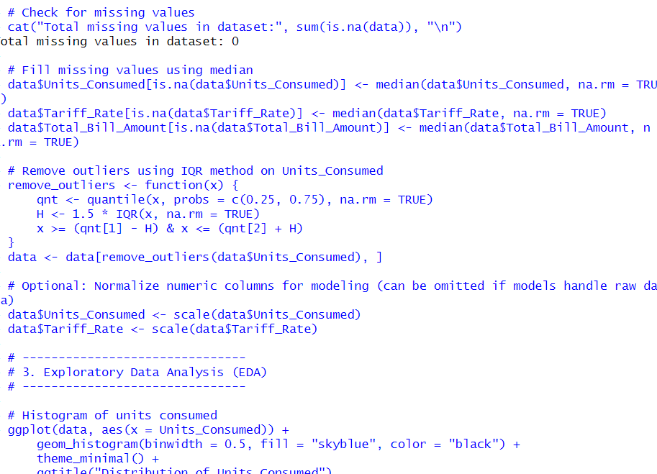
MODULE IMPLEMENTATION

Slide 11
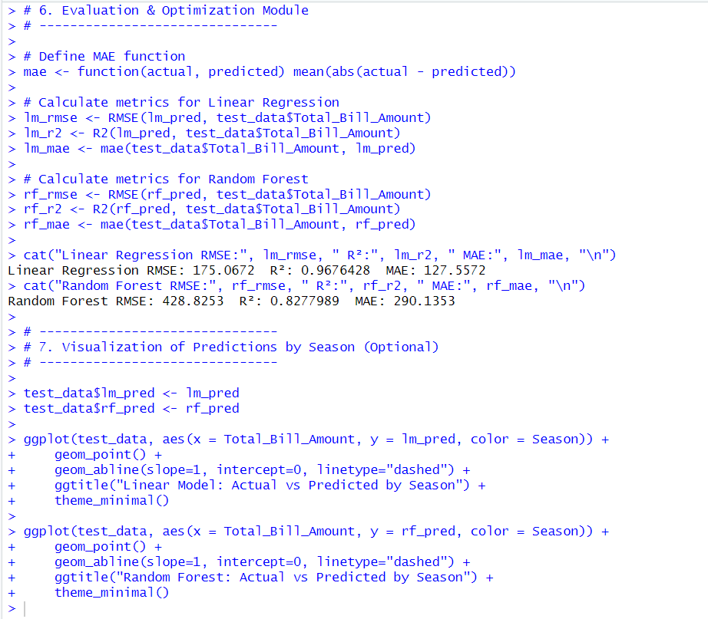
MODULE IMPLEMENTATION

Slide 12
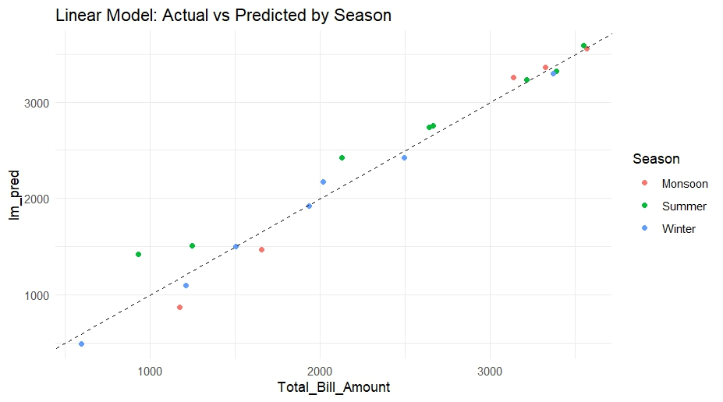
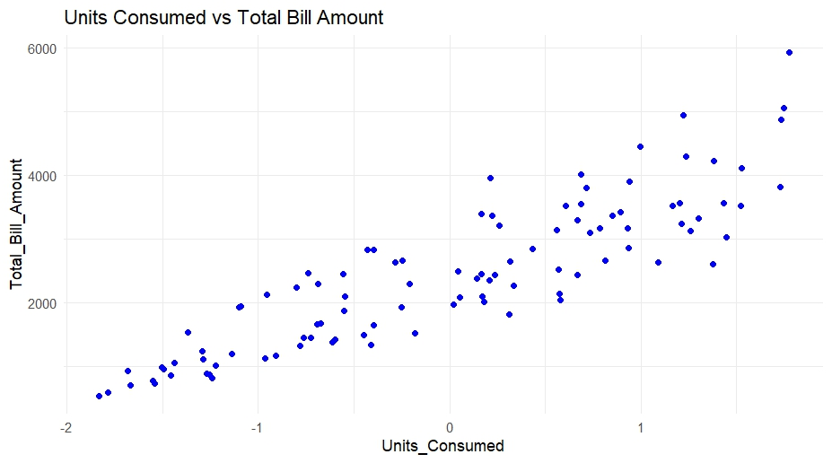
OUTPUT

Slide 13
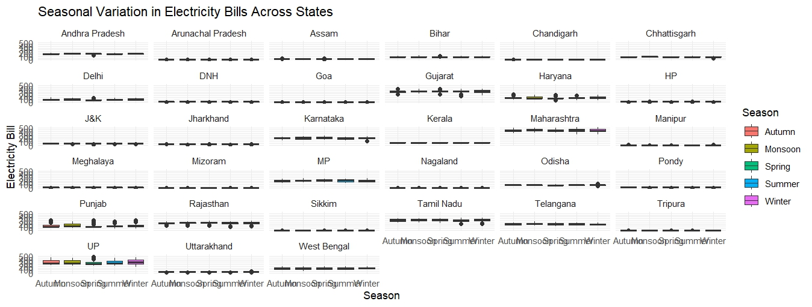
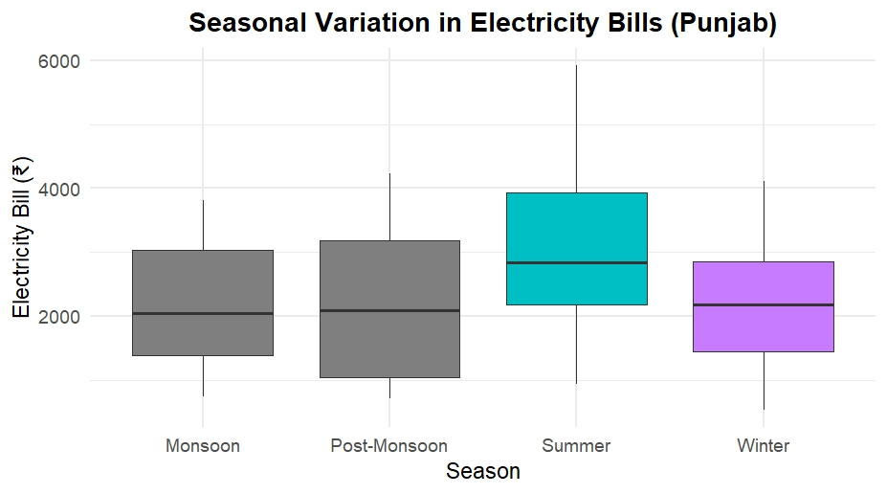
OUTPUT

Slide 14
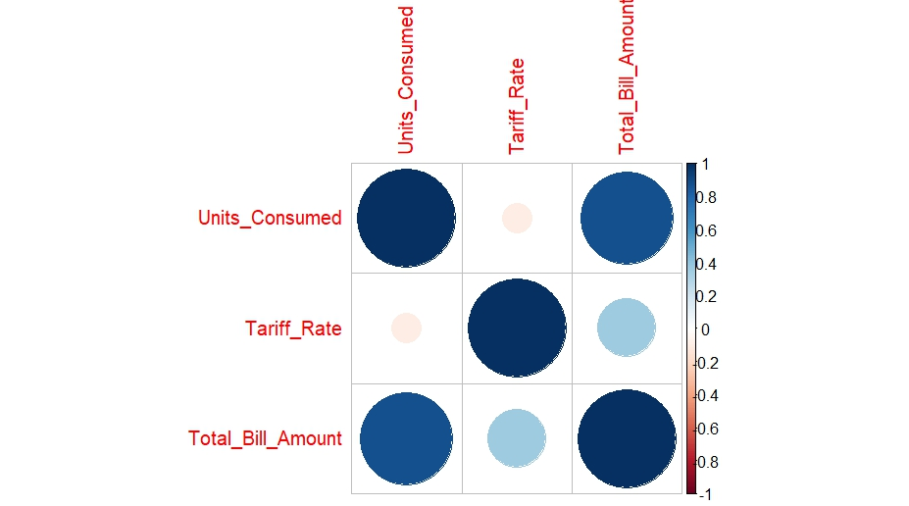
OUTPUT

Slide 15
tt
THANK YOU…

